Slide 1

Airport database management

Slide 2

-PURPOSE
-ERD
-Gannt Chart
-Creating table codes
-Inhabited stuff in Aircraft
-INSERT data
-Queries
-Problems I faced with

Slide 3
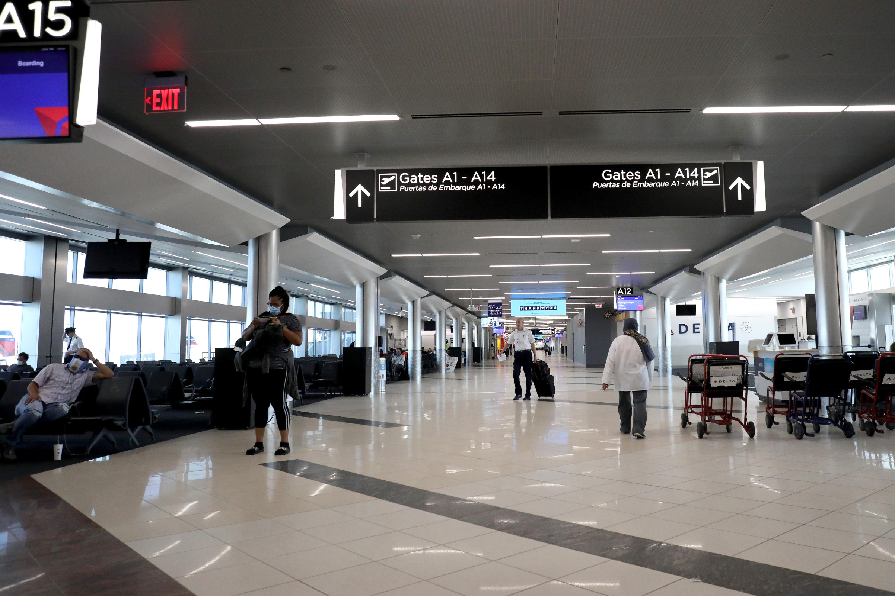
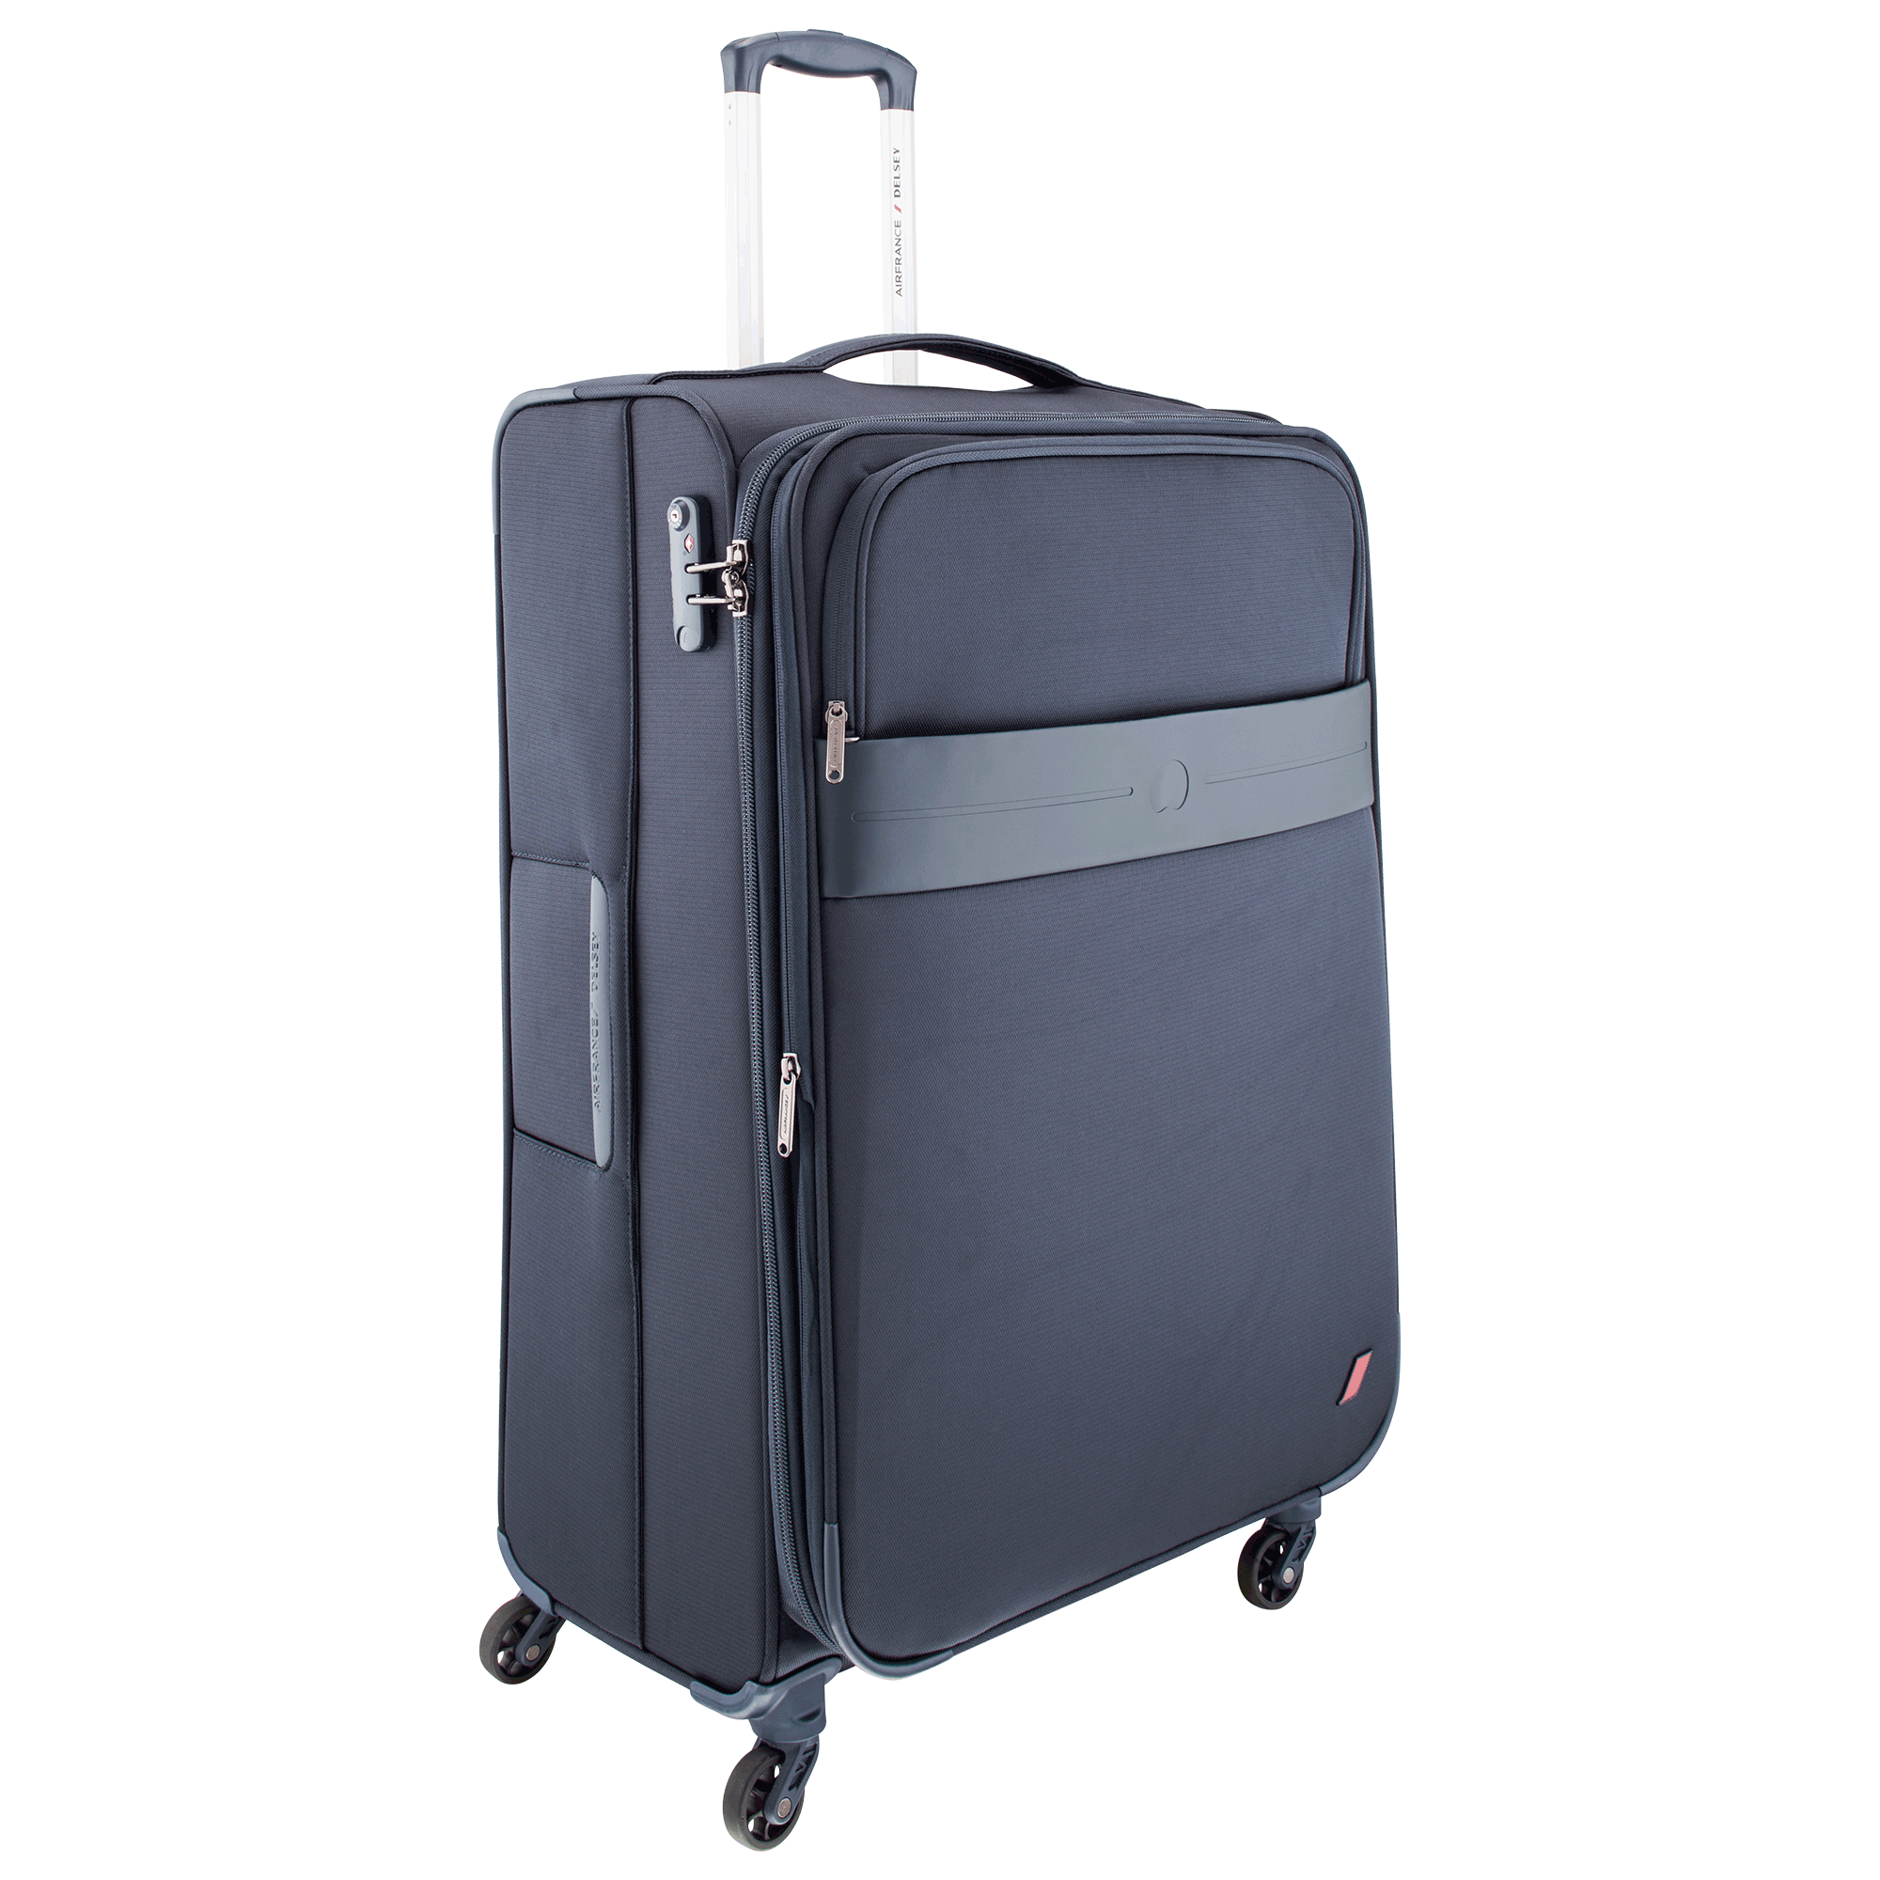
purpose
Project was aimed to create useful database of passengers, employees, luggage in airport. It includes data of employee mainly their salary, which can changed easily any time.
Main purpose is to save passengers to data, who tried to bring inhabited stuff in luggage. And in future if that passenger wants to cross country border, he will be checked twice by police.

Slide 4
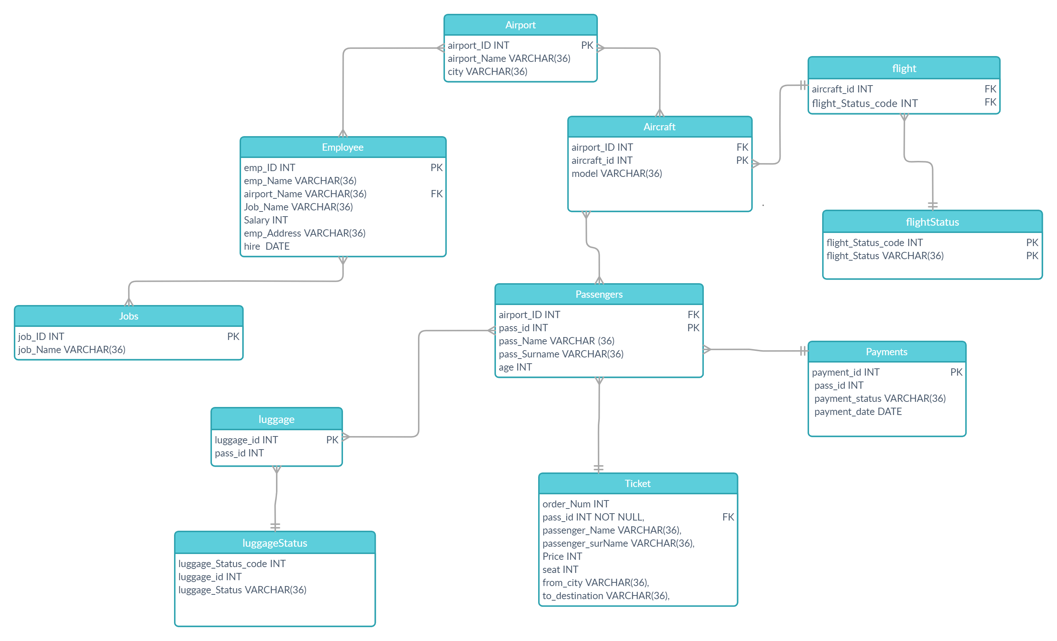
ER D IAGRAM

Slide 5
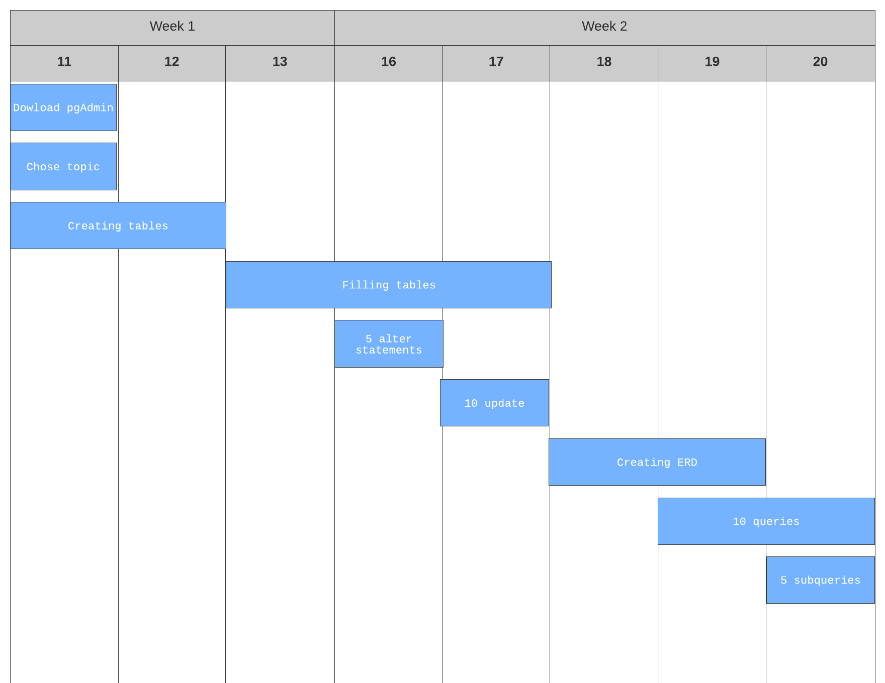
GANTT CHART

Slide 6
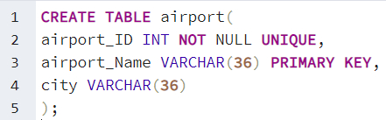
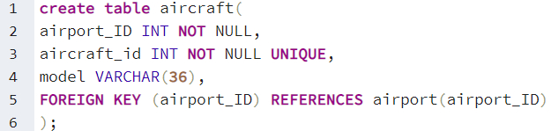
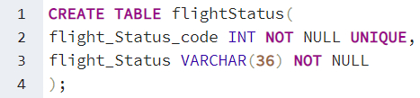
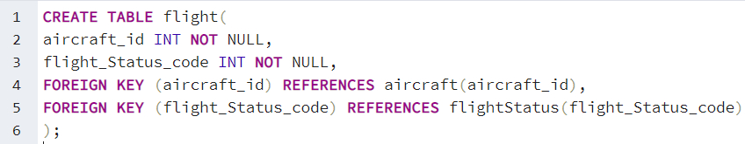
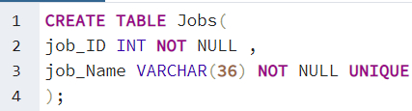
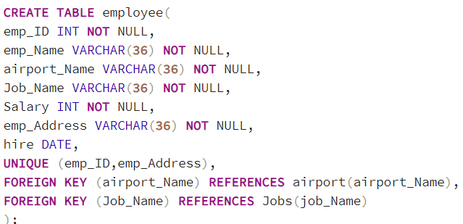
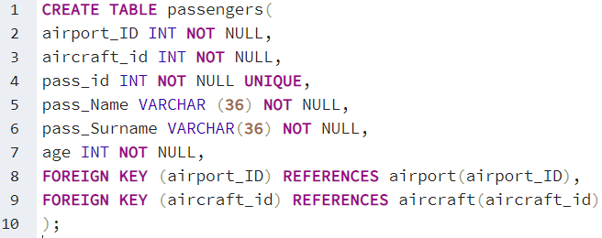
Creating tables

Slide 7

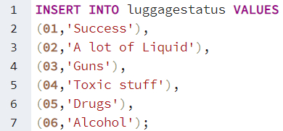



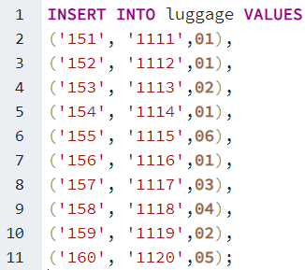


INHABITED STUFF IN AIRCRAFT
02
03
04
05
06

Slide 8
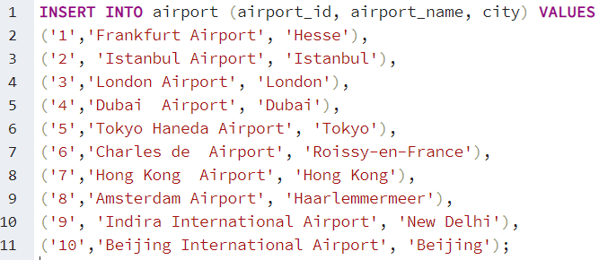
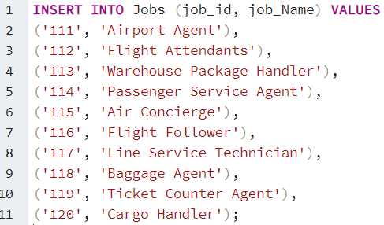
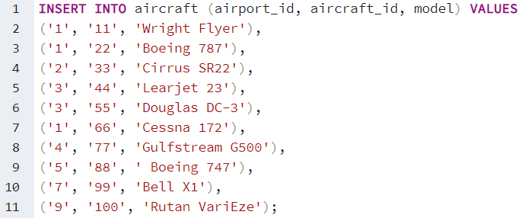
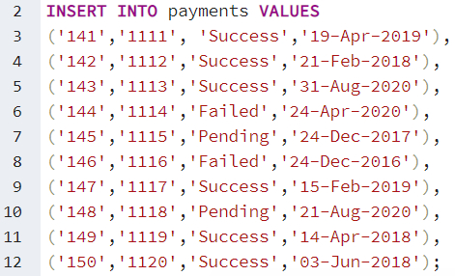
INSERT DATA TO TABLES

Slide 9
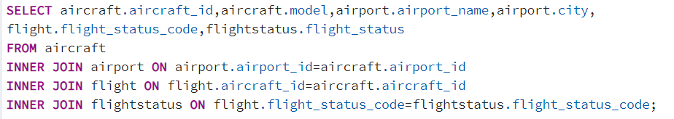
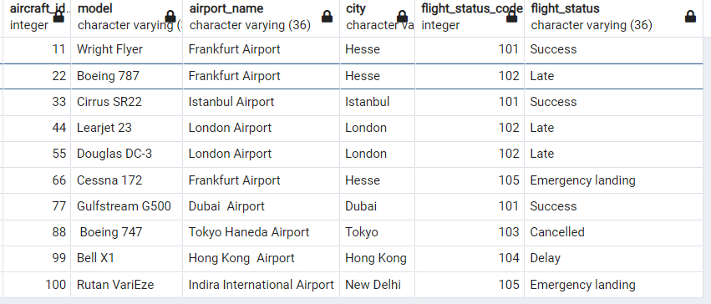
Just imagine administrator of airport said to increase salary of employees who have been working since 2013.
That query shows flight status of each
aircraft. It includes id,model,airport
name flight and flight status code.

Slide 10
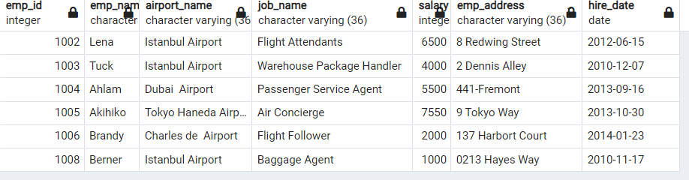
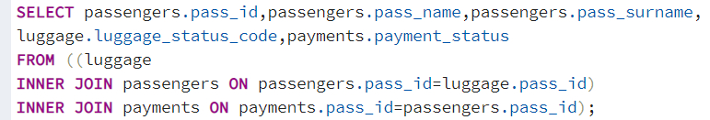
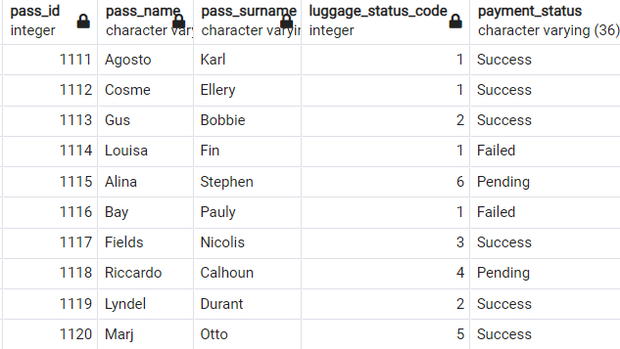
QUERIES
Query which shows all employee which hire date between 2010 and 2015
Query of showing Payment status and luggage status code of each passenger

Slide 11

PROBLEMS I FACED WITH
The first challenge was to be used to work with PgAdmin I have never worked in PgAdmin.
Generally, I have faced problems when I was coding in SQL. Obviously, I open our dear friend Google and search solutions for problems.
First prototypes of my tables was not perfect. So day by day I tried to change it to right way. I deleted, few times inserted new rows, did new constraints as PK, FK, UNIQUE.

Slide 12
REFERENCE LIST
https://www.lucidchart.com/pages/examples/gantt-chart-maker
https://creately.com/
https://www.w3schools.com/sql
Photoshop CS6
PgAdmin

